Slide 1
Elimination of unlawful housing discrimination and promotion of decent and affordable housing through advocacy and education.
50th Anniversary of the
Fair Housing Act
Long Island Housing Services’ Mission:
What is
Fair Housing?
Presented by:
Long Island Housing Services, Inc.
LIHS gratefully acknowledges the support of the U.S. Dept. of Housing and Urban Development Fair Housing Initiatives Program
LIFairHousing.org/li50fha

Slide 2
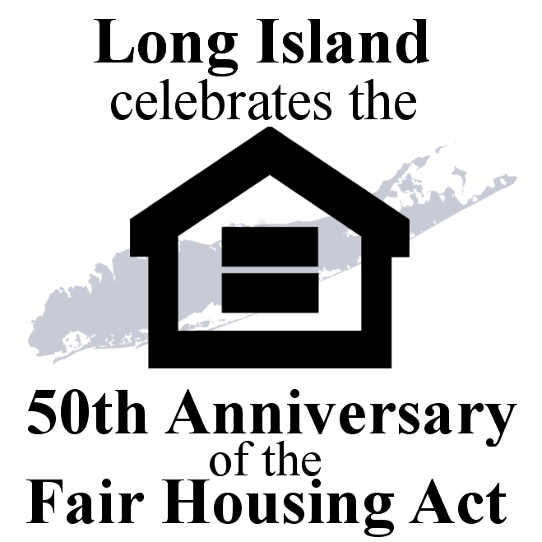
Title VIII of the Civil Rights Act of 1968
The Fair Housing Act:
In 1968, within a week after the assassination of Rev. Dr. Martin Luther King, the Fair Housing Act was passed.

Slide 3
What is Fair Housing?
It is U.S. policy and law to promote equitable housing choice and eliminate segregation.
Fair housing means that
all people have the right to
live in the housing of their choice
that they can afford
free from discrimination.*
*Discrimination: Denial of equal treatment and opportunity

Slide 4
What is Fair Housing?
Fair housing laws
ensure equal access and
mandate that people have
equal housing opportunities and
not be subjected to
discrimination based upon
legally protected categories.

Slide 5
Who is protected under the Fair Housing laws
?

Slide 6
U.S. government
New York State
County
FAIR
HOUSING
laws exist on
3 levels:

Slide 7
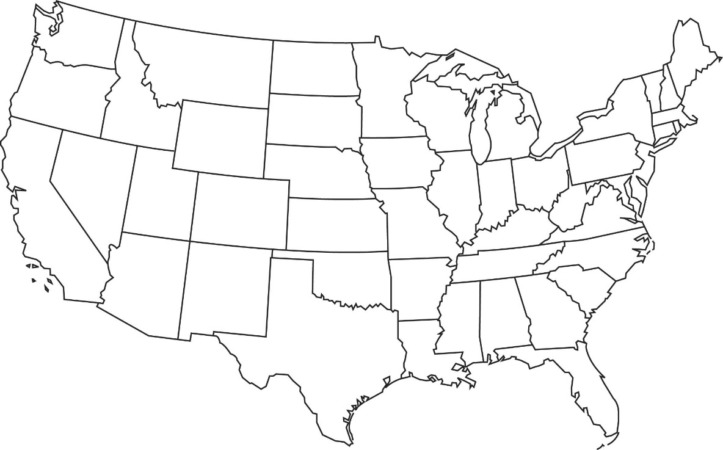
It is against Federal (U.S. Government) Fair Housing Law to discriminate in housing because of a person’s:
Race
Color
National Origin
Religion
Disability
Familial Status
Sex including Sexual Orientation and Gender Identity

Slide 8
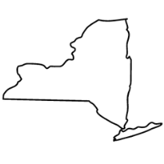
In New York state, it is also against the law to discriminate in housing because of a person’s:
Marital status
Sexual orientation
Gender Identity
Gender Expression
Source of Income*
Military Status
Age (over 18)
Creed
Arrest**
Domestic Violence Victim
*Source of income includes public assistance, Section 8, SSD, SSI, and court-ordered child support.
** Arrest includes favorably resolved arrest, an adjournment in contemplation of dismissal (ACOD), and a sealed conviction record, or a youthful offender adjudication.
In addition to Federal protections on the basis of Race, Color, National Origin, Religion, Sex, Disability, and Familial Status.

Slide 9
In Suffolk County, it is also against the law to discriminate in housing because of a person’s:
Group Identity*
Veteran Status
*Group Identity includes actual or perceived:
Age (over 18)
Alienage or Citizenship Status
Gender
Sexual Orientation
Military Status
In addition to Federal (Race, Color, National Origin, Religion, Sex, Disability, and Familial Status )and New York State (Marital Status, Sexual Orientation, Gender Identity, Gender Expression, Age (over 18), Military Status, Creed) protections.
Nassau County has the same protections covered under Federal and State laws.

Slide 10
In Nassau County, it is also against the law to discriminate in housing because of a person’s:
Ethnicity
Veteran Status
First Responder Status
In addition to Federal (Race, Color, National Origin, Religion, Sex, Disability, and Familial Status )and New York State (Marital Status, Sexual Orientation, Gender Identity, Gender Expression, Age (over 18), Military Status, Creed) protections.

Slide 11
Familial Status Protections
Familial Status includes:
Someone with 1 or more children under the age of 18
A pregnant woman
Foster parents and adoptive parents
Someone who has custody or guardianship of a child
.

Slide 12
Familial Status Protections
The Fair Housing Act makes it illegal to:
Require an additional security deposit
Segregate families with children (e.g. only downstairs units)
Limit or restrict the use of the housing complex’s pool, elevators, common areas, etc.
Evict a family after a baby is born or adopted
.

Slide 13
Sexual Harassment under the Fair Housing Act
Discrimination based on sex includes a protection against sexual harassment:
Deliberate or repeated unwelcome comments
Gestures or physical contact that create a hostile environment
Example: Asking for sexual favors in exchange for an apartment, in lieu of rent, offers of reduced rent or extra amenities, etc.

Slide 14
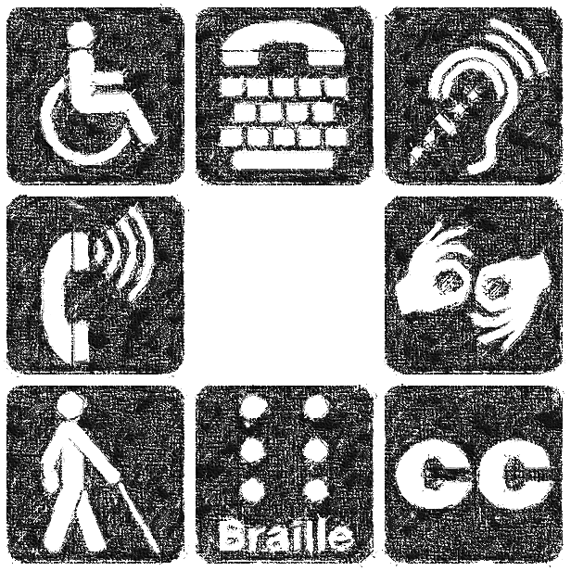
Who is Disabled?
“Disability” means a person who has
a physical or mental impairment
that substantially limits
one or more major life activities.
One can have either a history of the impairment
or can be viewed by others as having an impairment.
Notes:
**New York State Human Rights Law does not state that a person must one or more major life activities. Under New York State Human Rights Law, a person can have a temporary disability such as an injury from work which a person is receiving worker’s compensation.

Slide 15
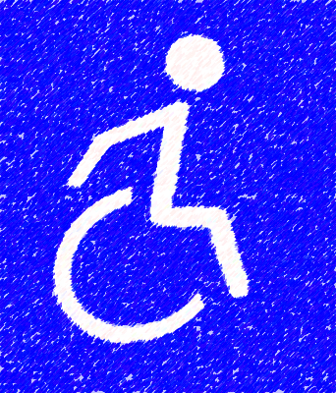
Disability
Major Life Activities include:
Walking
Seeing
Hearing
Speaking
Breathing
Learning
Working
Caring for your daily needs

Slide 16
Disability
Providing Documentation of a Disability
Generally, a landlord may NOT ask:
“Do you have a disability?”
“How severe is your disability?”
“May I have permission to see your medical records?”
“Do you take medications?”
“Why do you receive SSI?”

Slide 17
Disability
Providing Documentation of a Disability
If your disability is obvious to others, you should NOT be required to provide documentation.
Otherwise you can:
Show a copy of your current handicapped parking tag
Provide a statement from a doctor, therapist, case manager, peer support group, etc.
You should not need to provide copies of your medical records

Slide 18
What types of
housing
discrimination
?
are prohibited

Slide 19
Prohibited practices
refusal to rent or sell
refusal to negotiate
making housing unavailable

Slide 20
Prohibited practices
denying a dwelling
falsely denying housing availability for inspection, rental or sale

Slide 21
Prohibited practices
Blockbusting
Persuade owners to sell or rent for profit
by telling them that persons
of a particular race, color, national origin, sex, familial status, religion or disability
are moving into the neighborhood.
Steering
Directing prospective home buyers or tenants
to neighborhoods or buildings
based on their protected category
Notes:
Blockbusting is also illegal. This is when for profit, a real estate or lending professional tries to get people to rent or sell their property by telling them that persons of a particular protected category are moving into the neighborhood.
Steering, redlining and reverse redlining are also prohibited.
Steering is directing prospective home buyers or tenants to neighborhoods or buildings based on their protected categories – basically forced segregation.

Slide 22
Prohibited practices
Redlining
Unwillingness to lend to
applicants or borrowers in particular neighborhoods or geographic regions
Reverse Redlining
Targeting people in certain geographic areas
for disadvantageous or abusive
loan terms and conditions

Slide 23
Prohibited practices
Refusal to make reasonable accommodations
…in rules, policies, practices, or services when such accommodations may be necessary for persons with a disability to have equal opportunity, full use and enjoyment of a dwelling
Example: Because of a vision impairment, a tenant requests permission to have a guide dog with her in her apartment. The housing provider has a no-pets policy. This is a request for a reasonable accommodation, and the housing provider must grant the accommodation.

Slide 24
Prohibited practices
Refusing to allow for reasonable modifications
…to properties when such modifications to structures are required by a person with a disability to allow them full use and access to a rental unit or common area, at the expense of the person with a disability
Example: Because of a mobility disability, a tenant wants to install grab bars in the bathroom. This is a reasonable modification and must be permitted at the tenant’s expense.
*Note- In 2010, New York State Human Rights Law was modified to recognize that modifications are accommodations. It also placed the expense on providers for modifications to common and public use space
Notes:
.

Slide 25
Prohibited practices
Examples: Unlawful advertising discrimination: verbal, printed, or graphic
“no children”
“mature persons”
“suitable for singles only”
“Christians Only”
“English Speakers Only”
“Ideal for a couple”
“Must have employment income”
“No Section 8”
“No Programs”
Logos that represent a particular race or religion, e.g. pictures featuring only White tenants.

Slide 26
Prohibited practices
Examples: Unlawful Terms and Conditions
Applying different standards and rules related to eviction, attempted eviction or non-renewal of a lease
Treating tenants differently in relation to repairs, lease violation notices and late fees

Slide 27
Prohibited Practices
Retaliation
Coercion, intimidation, threats and interference
Against persons who have exercised their Fair Housing rights
Against persons who have acted as a witness or aided others to exercise their Fair Housing rights

Slide 28
Prohibited Practices for Financing, Brokerage, and Appraisal Services
Refusing to make a mortgage loan
Refusing to provide information regarding loans
Setting different terms or conditions of financing
Refusing to purchase a loan
Denying access to brokerage services
.

Slide 29
“I don’t think it’s safe for you to live here because of your disability.”
Examples: Discriminatory Statements:
“I don’t rent to families with children.”
”I won’t rent a one-bedroom apartment to parent and child.”
“I don’t rent to African Americans, Hispanics, Jews etc.”
“I don’t want foreigners living in my complex.”
“It’s not safe for young children because there are stairs.”
“No Programs accepted.”
.

Slide 30
Examples: Discriminatory Harassment:
Sexual (gender), racial, ethnic, religious, disability or familial status harassment
by the owner, employees of owner,
the management company,
employees of the management company,
or other tenants.
“Wouldn’t you be more comfortable somewhere else?”

Slide 31
What
types of housing
are covered
by the federal
Fair Housing Act
?

Slide 32
Housing covered by the federal Fair Housing Act
Single Family Homes
Single Family homes owned by private persons when a real estate broker and/or discriminatory advertising is used to sell or rent the home
Single Family homes not owned by private persons (for example, owned by corporations or partnerships) even if a broker is not used to sell or rent the home

Slide 33
Housing covered by the federal Fair Housing Act
Multifamily Dwellings
Multifamily dwellings with 5 or more units, including rooming houses
Multifamily dwellings with 4 or fewer units, if the owner does not live in one of the units.*
* NYSHRL covers three or more units

Slide 34
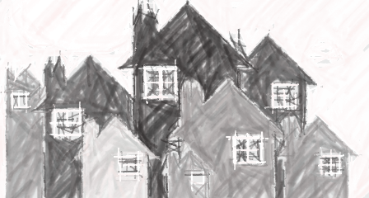
Other types of dwellings covered under the Fair Housing Act
Group Homes
Nursing Homes
Assisted Living Facilities
Residential Hotels
Dormitories
Condos and Cooperatives
Manufactured and Mobile Homes
.

Slide 35
How do we
overcome
fair housing challenges
?

Slide 36
Fair Housing Strategies
Education
Advocacy
Enforcement

Slide 37
How Do You Protect Your Fair Housing Rights?
Anyone who believes he or she has been discriminated against can file a complaint.
If you want to discuss options, or obtain help from a professional Fair Housing advocate…
Contact Long Island Housing Services, Inc.
(631) 567-5111 ext. 375
info@LIFairHousing.org

Slide 38
Protecting Your Fair Housing Rights
*This chart is for administrative complaints, not judicial complaints filed in Federal District Court or NYS Supreme Court.
Statute of Limitations: Administrative Complaint= 1 year and Federal Court = 2 years

Slide 39
Call Long Island Housing Services, Inc. 631-567-5111 ext. 375
info@LIFairHousing.org
Federal
State
U.S. Department of
Housing and Urban Development
New York FHEO Office
26 Federal Plaza, Room 3532
New York, NY 10278-0068
https://www.hud.gov/program_offices/fair_housing_equal_opp/online-complaint
N.Y. State Division of Human Rights
One Fordham Plaza, 4th Floor
Bronx, NY 10458
https://dhr.ny.gov/complaint
Nassau County
Nassau County Commission
on Human Rights
240 Old County Road
Mineola, NY 11501
https://www.nassaucountyny.gov/414/Human-Rights-Commission
Suffolk County
Suffolk County
Human Rights Commission
100 Veterans Memorial Highway Suite #1
Hauppauge, NY 11788
http://www.suffolkcountyny.gov/Departments/HumanRightsCommission/ComplaintProcess.aspx

Slide 40
Fair Housing Laws
Federal Laws:
Fair Housing Act
Title VIII of the Civil Rights Act of 1968
Fair Housing Amendments Act
Passed in 1988
Added provisions related to familial status and disability

Slide 41
Fair Housing Laws
New York State Human Rights Law:
N.Y. Executive Law Section 290 et seq.
Nassau County Human Rights Law – Local Law:
9-2006 eff.1-07
Suffolk County Human Rights Law:
Local Law No. 58-2014 eff. 1-21-15

Slide 43
Long Island Housing Services, Inc. 631-567-5111 ext. 375
info@LIFairHousing.org
Updated March 2019.
LIFairHousing.org/li50fha

